Slide 1
Agile Case Study
By:
Harshith Mohan Kumar
Zayd Jamadar
Nabeel Khan
Mrudhulraj Natarajan
Nikhil M
Notes:
Nabeel

Slide 2

Notes:
Harshith

Slide 3
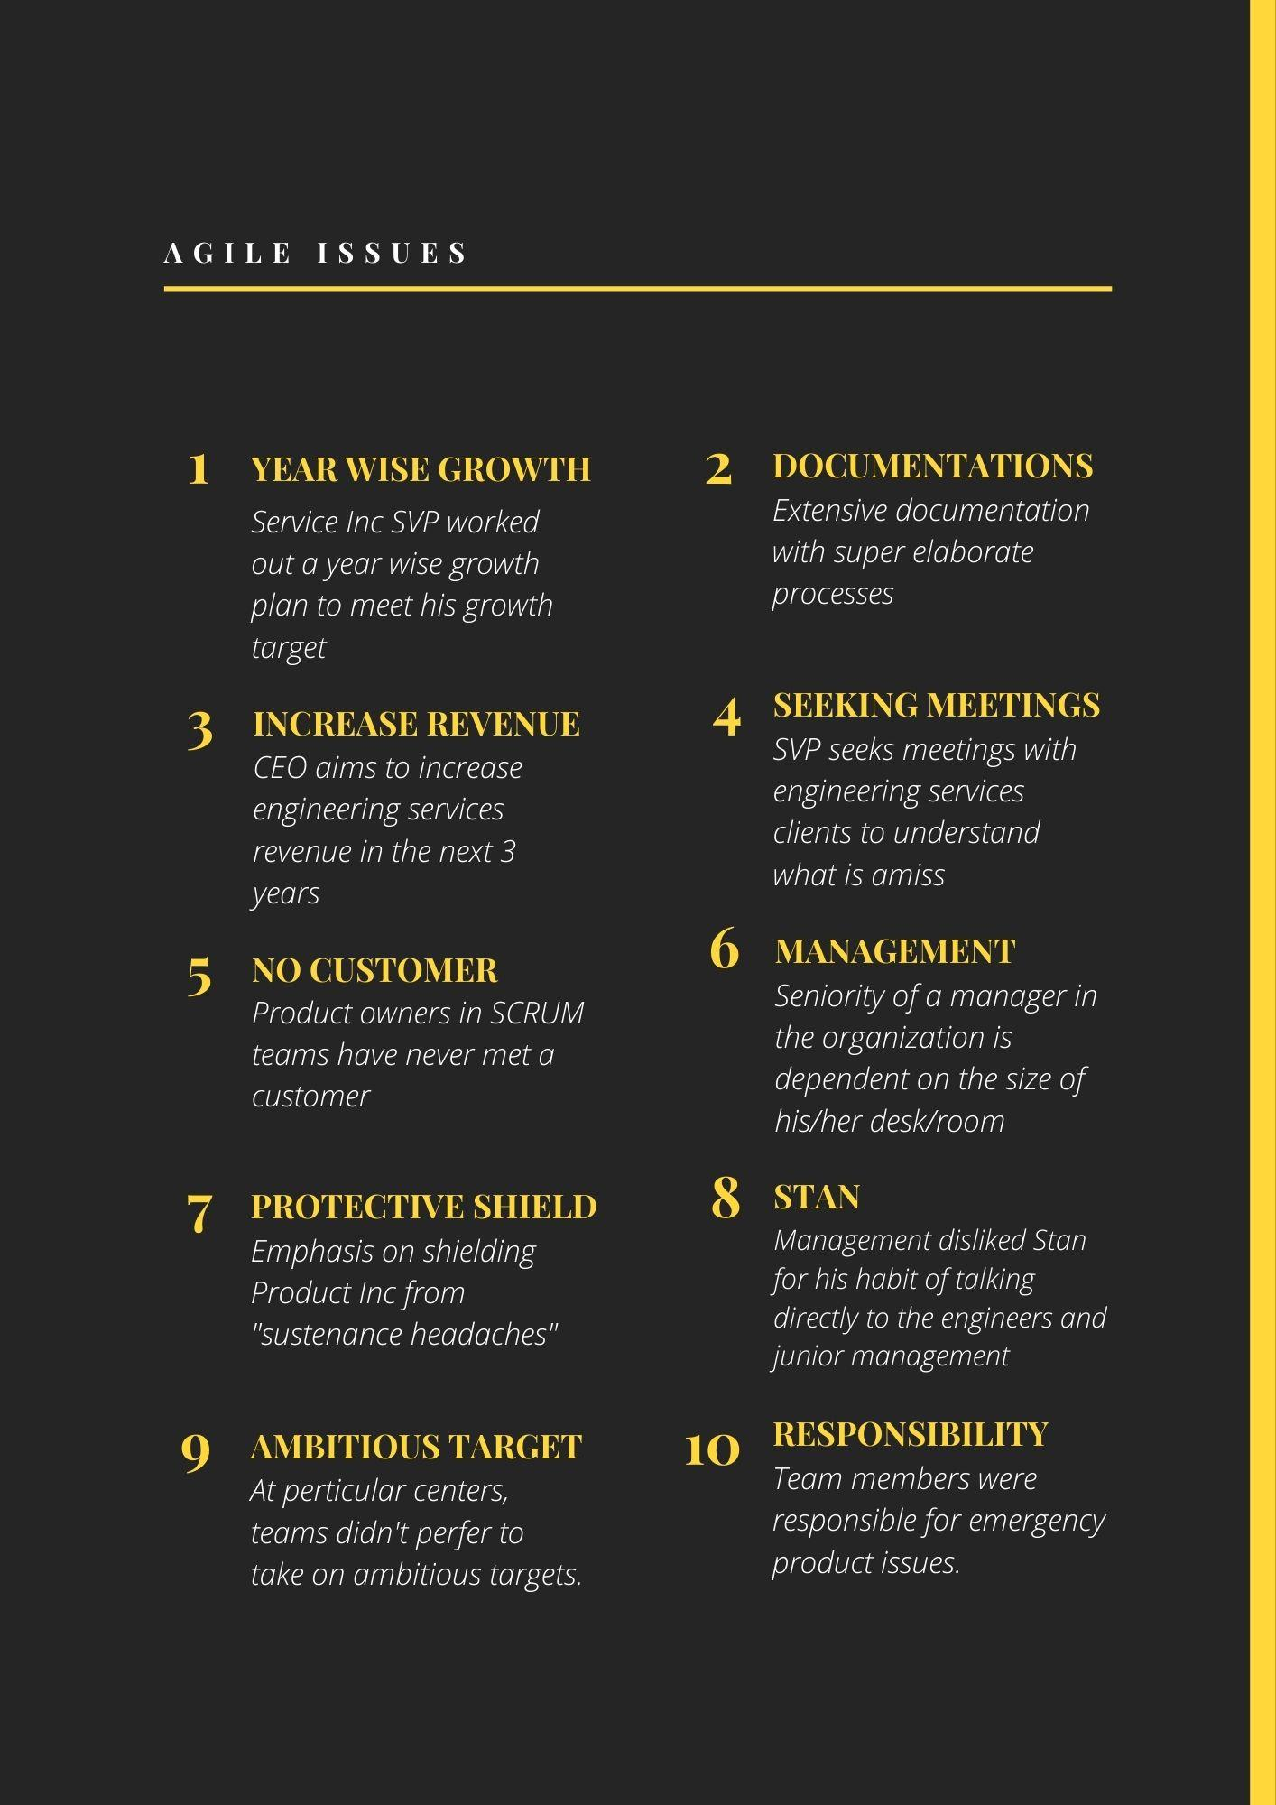
Failures in Agile
The infographic on the right contains the “failures” of Service Inc in following the Agile Manifesto
Ultimately, Service Inc went through a 6 month training period to “become Agile”
Notes:
Harshith

Slide 4
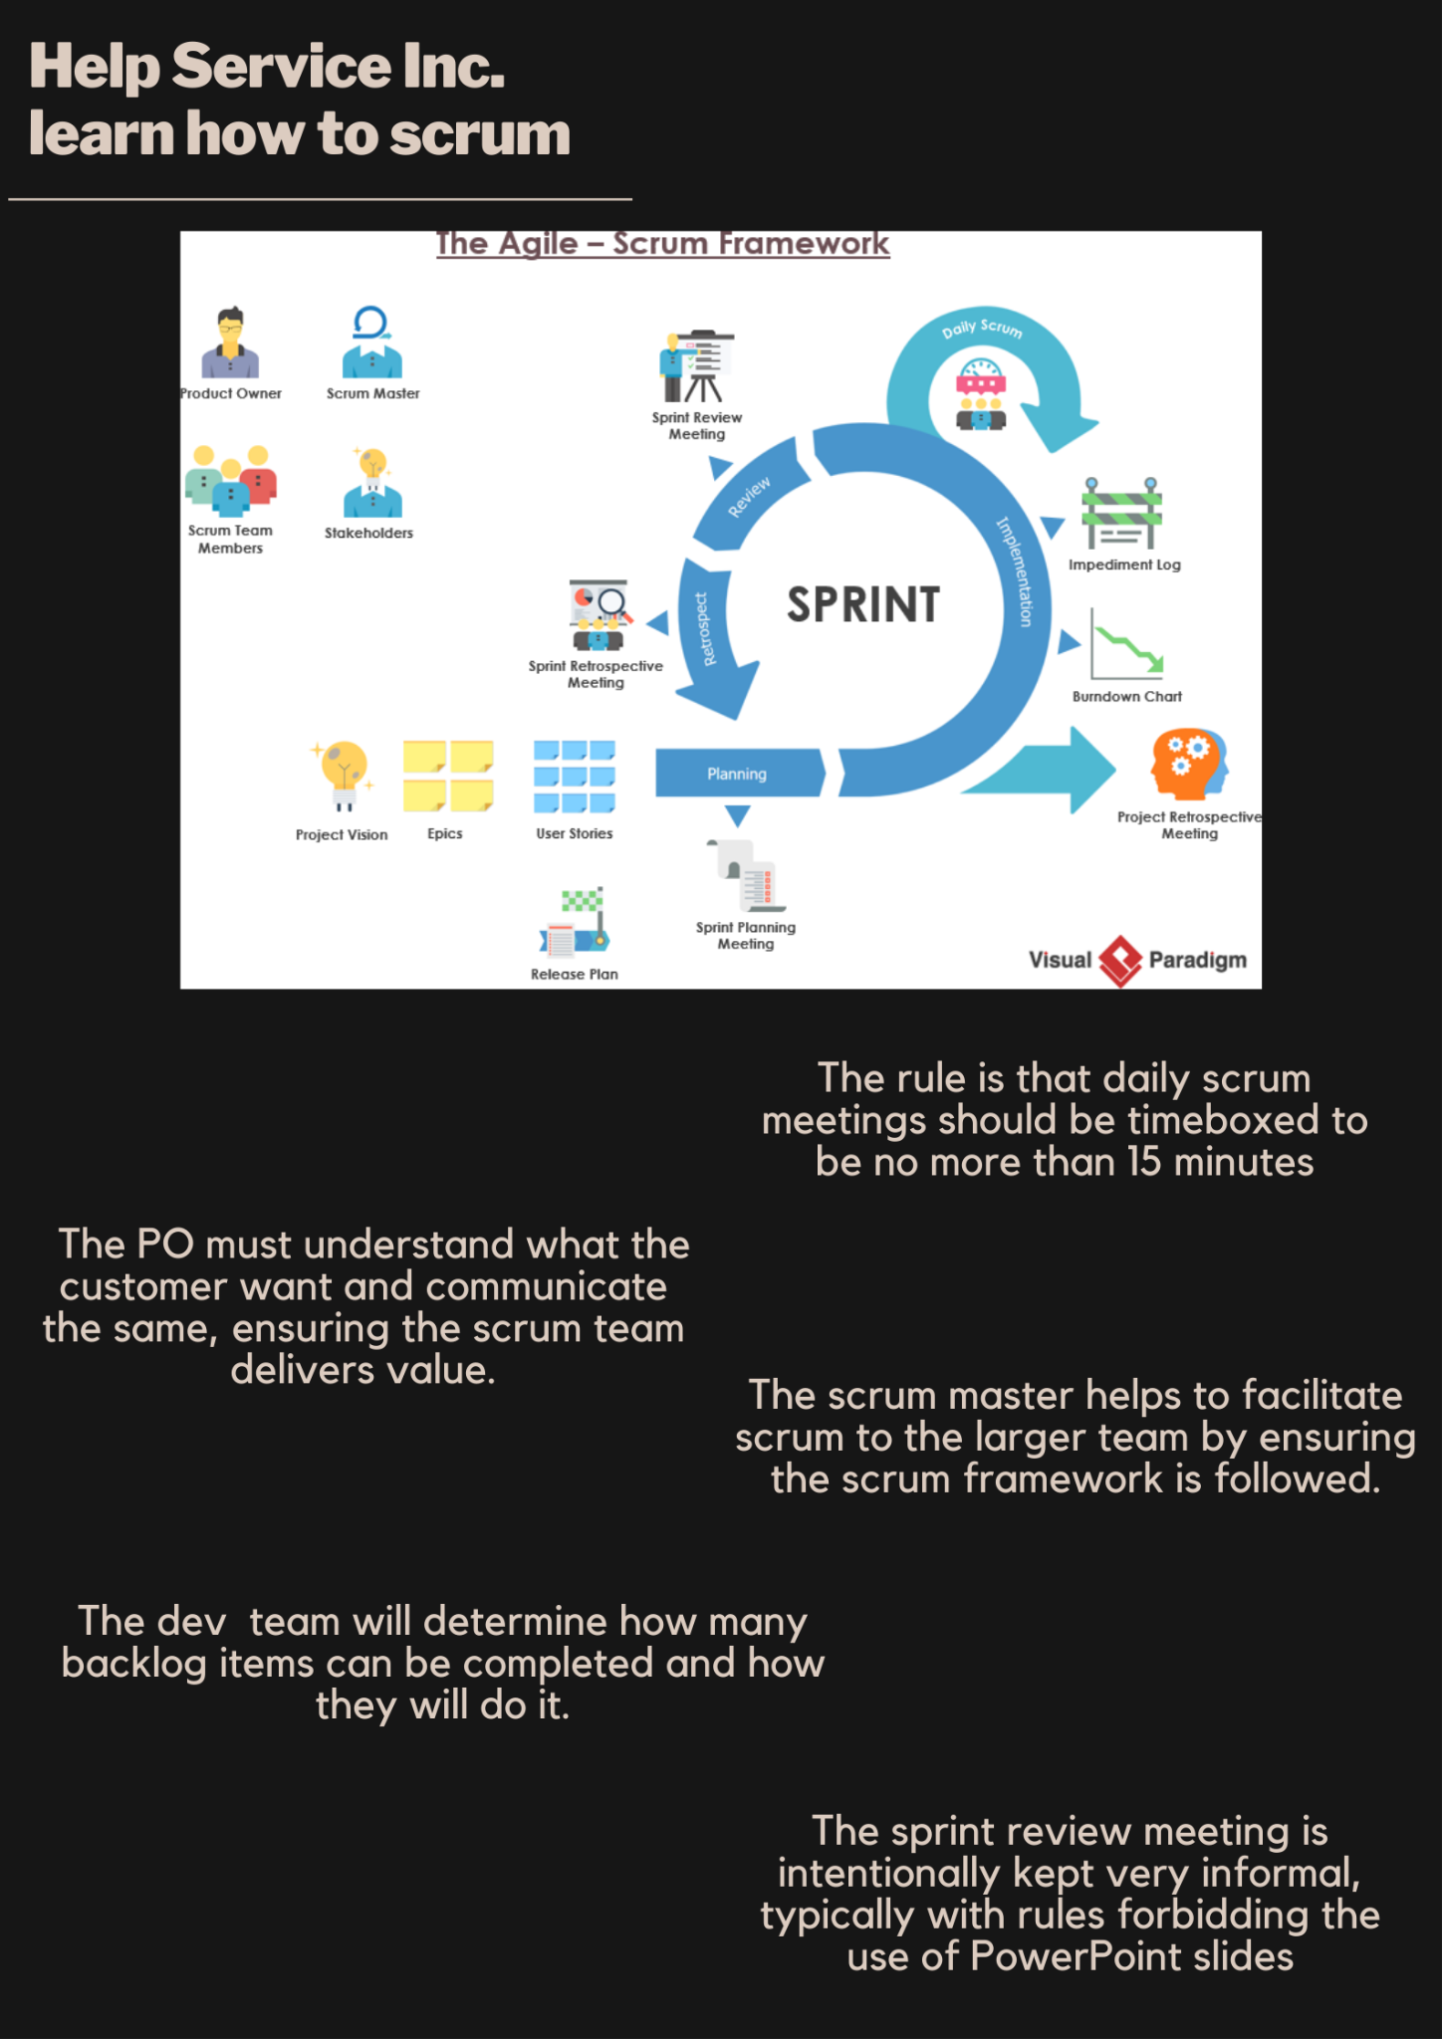
SCRUM Deviation
The infographic on the left contains some methods Service inc. could adopt to become more scrum compliant.
There are a lot of subtle errors which combine together resulting in the failure of the management in training the staff in agile methodologies.
Notes:
Zayd J

Slide 5
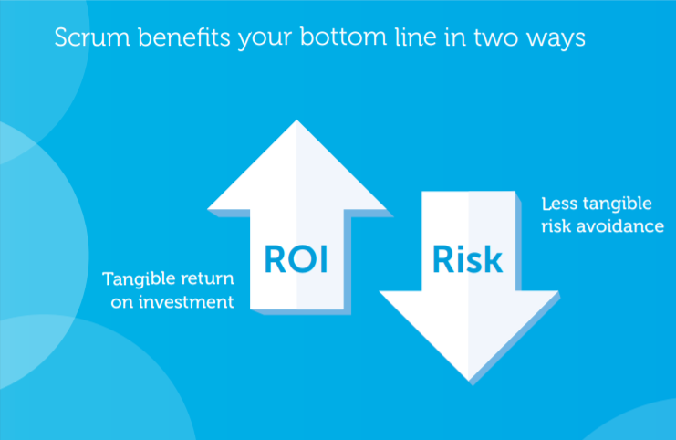
Financial aspects of SCRUM
Products and projects carry a lot of uncertainties
Errors in the business case
Management and contingency reserves
Cost of correcting and managing triggered risks
Scrum act as early warning systems
Scrum lowers internal risks
When you lower execution cost, you improve
margin and reduce investment payback period
Notes:
Nabeel

Slide 6
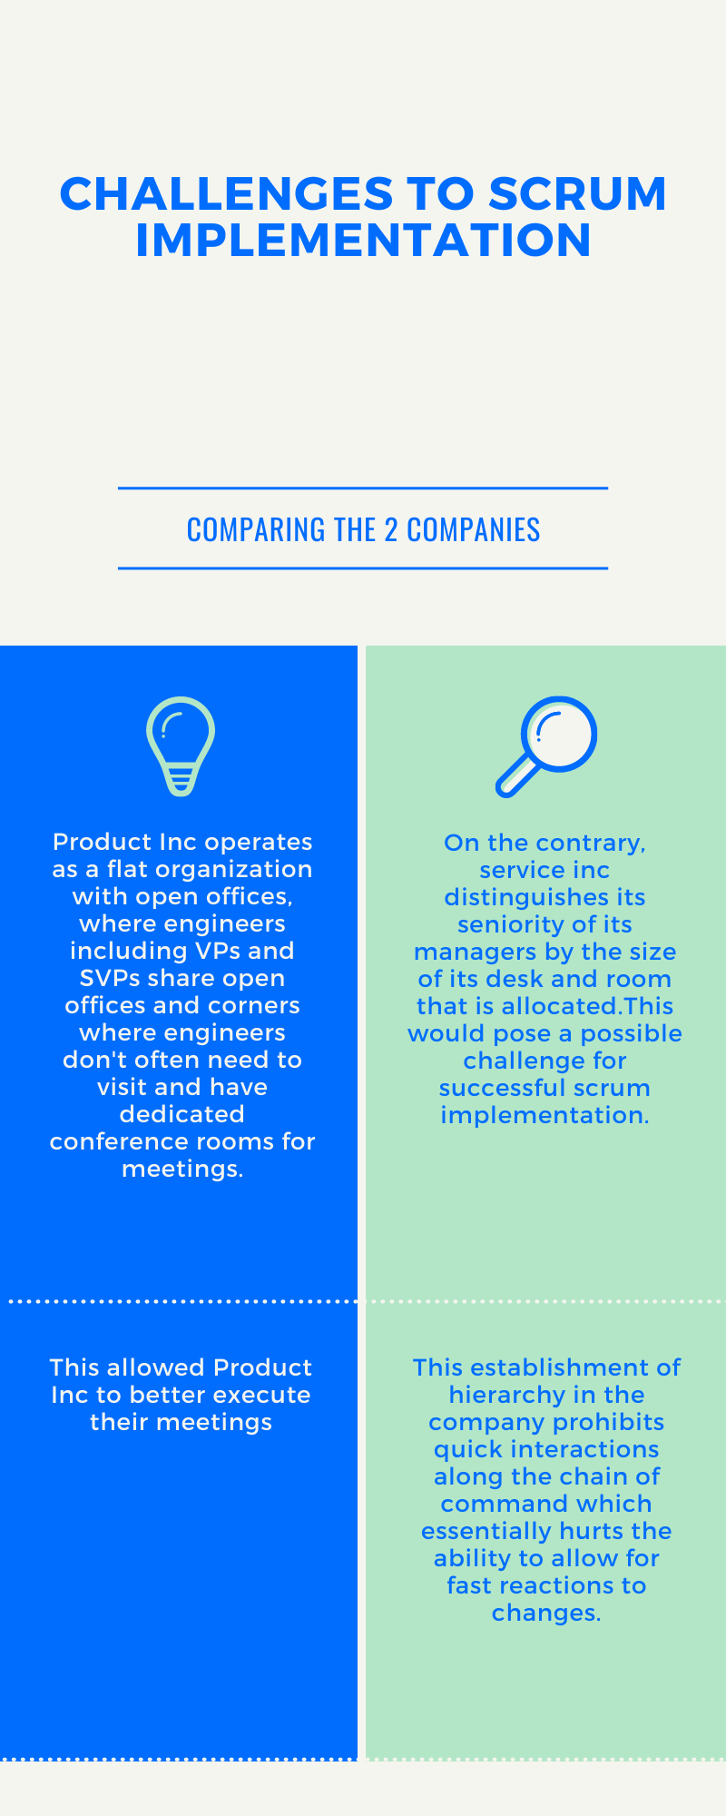
Pitfalls of Service Inc.
The infographic on the right shows the failure of service Inc to
implement scrum due to their cultural differences.
The daily scrum meetings took about 60-90 minutes with each
member getting around 10 minutes.
The scrum master decided and assigned tasks among team
members.
Instead of the backlog being realistic, it was rather ambitious and
the team wasn’t up to the task to complete it.

Slide 7
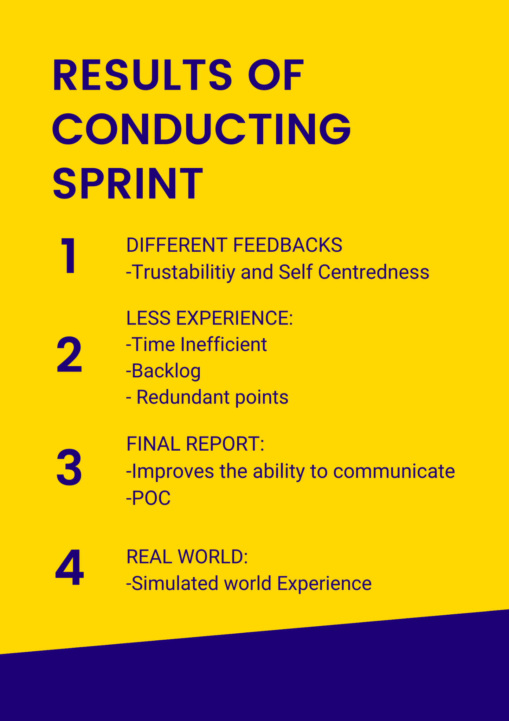
SPRINT ANALYSIS
The infographic on the right contains the “conclusions” that can be derived from the sprint conduction in the case study
The infographic clearly mentions the reasons Mr. Shan denied the approval for the Service Inc to work on Products
Notes:
Mrudhul

Slide 8
Thank You

